Slide 1

MavPASS Session
4/7/2022

Slide 2
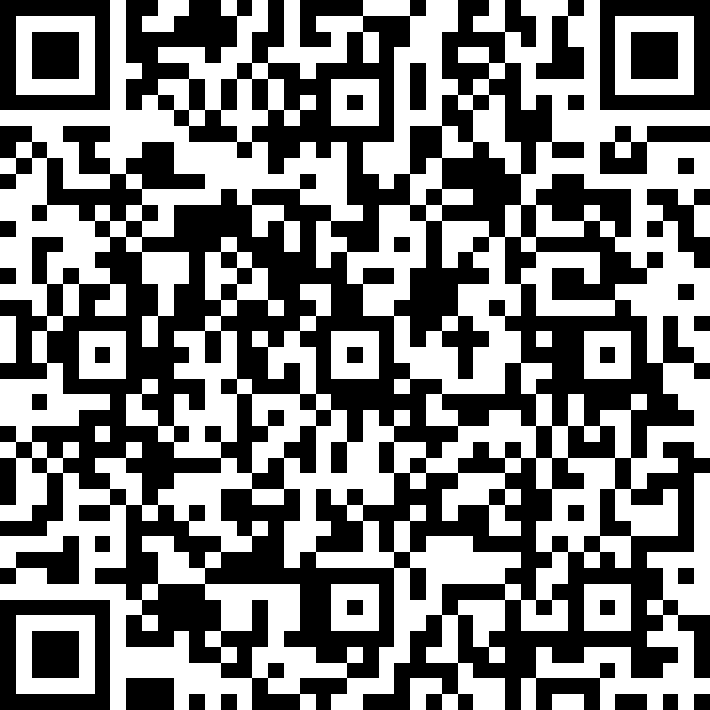
Attendance CIS121 MavPASS Session
https://forms.office.com/pages/responsepage.aspx?id=xscRULQKq0ae9PrnSpIaf8Jeg9NwiYFJtEEipPejT79UNkFaVjJCV1YxWDVWV0NJRTVMOUFQUTlPUSQlQCN0PWcu

Slide 3
Attendance CIS121 MavPASS Session

Slide 4
Ice breaker
Do you play any sports? Or have any hobbies?

Slide 5

https://replit.com/@amirNigusie/MavPass#main.py

Slide 6
What is recursion?

Slide 7
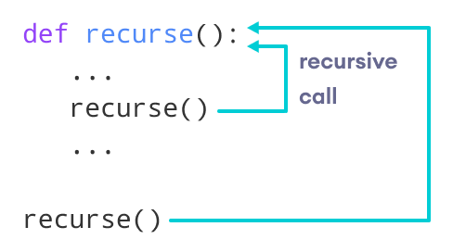
The following image shows the working of a recursive function called recurse.

Slide 8
Practice problems
1, Write a recursive function that takes a number and returns the sum of all the numbers from zero to that number.
I will call this function ‘cumulative’. If I provide 10 as an input it should return the sum of all the numbers from zero to 10. That is 55.

Slide 9
What is polymorphism

Slide 10
polymorphism

Slide 11

What are and come with examples for each one of them.
Hierarchy, inheritance, data encapsulation

Slide 12

Hierarchy Hierarchical Inheritance: When more than one derived classes are created from a single base this type of inheritance is called hierarchical inheritance. In this program, we have a parent (base) class and two child (derived) classes. Inheritance Inheritance is a powerful feature in object oriented programming. It refers to defining a new class with little or no modification to an existing class. The new class is called derived (or child) class and the one from which it inherits is called the base (or parent) class. data encapsulation Encapsulation is the packing of data and functions that work on that data within a single object. By doing so, you can hide the internal state of the object from the outside. This is known as information hiding. A class is an example of encapsulation.

Slide 13

What is polymorphism
Polymorphism in python defines methods in the child class that have the same name as the methods in the parent class. In inheritance, the child class inherits the methods from the parent class. Also, it is possible to modify a method in a child class that it has inherited from the parent class.

Slide 14
Discuss about
protected
private
public

Slide 15
Find and describe the error.
class CIS: def __init__(self): self.name = "Name" self.__age = "age" def this(self): return self.name +" is " + self.__age mav = CIS() print(mav._CIS__age) print(mav.name)

Slide 16
Can you tell us what this code is doing ?
class Language: def say_hello(self): raise NotImplementedError("use the French class") class French: def say_hello(self): print("Bonjour") class Amharic: def say_hello(self): print("Selam") def intro(langu): langu.say_hello() Jone = French() Amir = Amharic() intro(Jone) intro(Amir)

Slide 17
Give an Example by Create an object that will inherit all of the variables and methods of the parent class and display it.

Slide 18
My Example ☺
class Vehicle:
def __init__(self, name, max_speed, mileage):
self.name = name
self.max_speed = max_speed
self.mileage = mileage
class Bus(Vehicle):
pass
School_bus = Bus("School Volvo", 180, 12)
print("Vehicle Name:", School_bus.name, "Speed:", School_bus.max_speed, "Mileage:", School_bus.mileage)

Slide 19

Practice problem
Make a class with two instance variables: the object's name and the price. Make a method that tells you the name and class of the object. Make a variety of fruits, each with its own name and price.

Slide 20

Practice problem
1, create a server for the dining of the university. With the classes food class, customer class and Menu class.

Slide 21
Practice problem
create student class with First Name, Last Name and Id. create Computer Science student class which takes First Name and Last Name in order to create full Name.

Slide 22
Practice problem
You are given an array of integers stones where stones[i] is the weight of the i^{th} stone.
We are playing a game with the stones. On each turn, we choose the heaviest two stones and smash them together. Suppose the heaviest two stones have weights x and y with x <= y. The result of this smash is:
If x == y, both stones are destroyed, and
If x != y, the stone of weight x is destroyed, and the stone of weight y has new weight y - x.
At the end of the game, there is at most one stone left.
Return the smallest possible weight of the left stone. If there are no stones left, return 0.
Example 1:
Input: stones = [2,7,4,1,8,1] Output: 1 Explanation: We combine 7 and 8 to get 1 so the array converts to [2,4,1,1,1] then, we combine 2 and 4 to get 2 so the array converts to [2,1,1,1] then, we combine 2 and 1 to get 1 so the array converts to [1,1,1] then, we combine 1 and 1 to get 0 so the array converts to [1] then that's the value of the last stone.
Example 2:
Input: stones = [1] Output: 1
Constraints:
1 <= stones.length <= 30
1 <= stones[i] <= 1000

Slide 23

Study tip:
Make connections with professors and other students
Rest and relax
Schedule time to study

Slide 24


Thank You
Amir Abaraya
amir.abaraya@mnsu.edu

